Slide 1
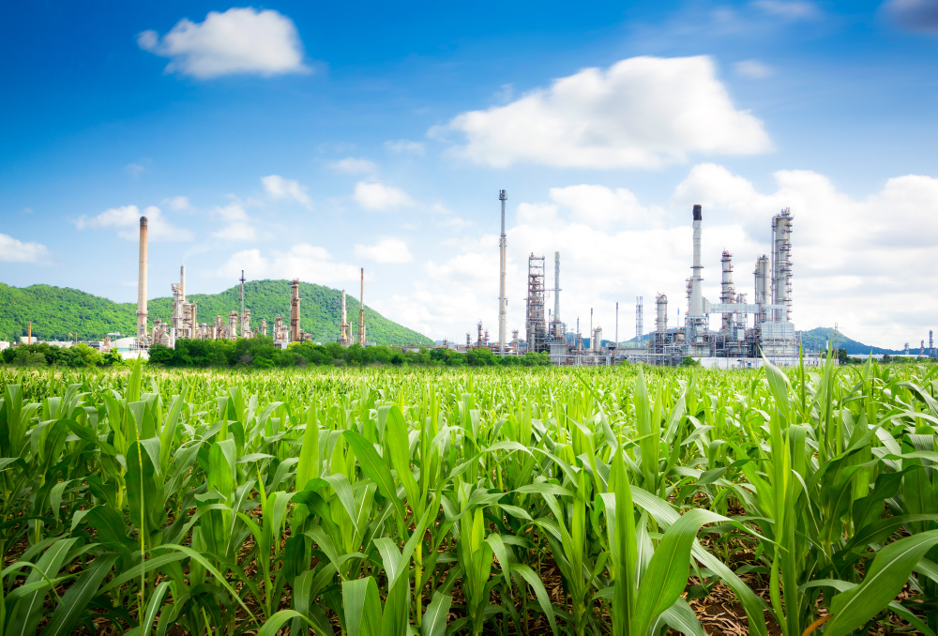
GTL technology
synthetic motor fuel production
St. Petersburg
2020

Slide 2
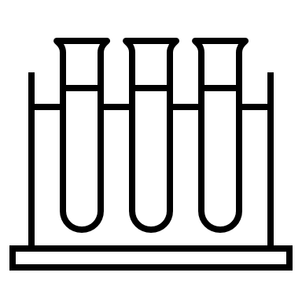
Green Technologies
The main goal of green technologies development is to reduce negative impact on the environment. It is achieved by increasing energy efficiency, reducing the volume of consumed resources, reducing the amount of waste and recycling. All of these processes are resulted in quality of life and health improvement of people. Developed countries are striving to solve environmental problems in an integrated manner, applying transition to a green economy through the implementation of government programs.
Best practices show that investments into green economy are growing in the world. Shares of companies that take into account environmental risks show more sustainable growth and stability. The interest and participation of government institutions stimulate entrepreneurs to finance ecological innovations and correspondingly green technologies not as a one-time action, but as an everyday routine.
According to the annual report of the British analytical company FTSE Russell for 2018, the green economy grew to $4 trillion or 6% of the total global economy, and thus reached the level of the mining sector. According to the forecast by 2030 the green economy should account for up to 10% of the gross world product.
One of these green technologies is the GTL technology. It allows to convert natural gas into a liquid state (gas-to-liquid technology) for the further production of diesel, gasoline, jet fuel and naphtha.
One of the main aspects of GTL technology is the quality of products, since GTL synthesis is better than treating. It is much easier to control the level of impurities in the synthesized products. This allows to produce cleaner products than refined in the traditional way. It is important for European diesel producers, which had to dramatically increase the cost of refining due to restrictions on the content of sulfur and aromatic components of fuel. At the same time crude oil supply with low sulfur content to the European market is decreasing from year to year and tend to continue. In addition, synthetic diesel produced from liquefied hydrocarbons has a higher cetane number of about 70, compared to 55 for conventional fuel.
SINTEZPROM CORPORATION

Slide 3
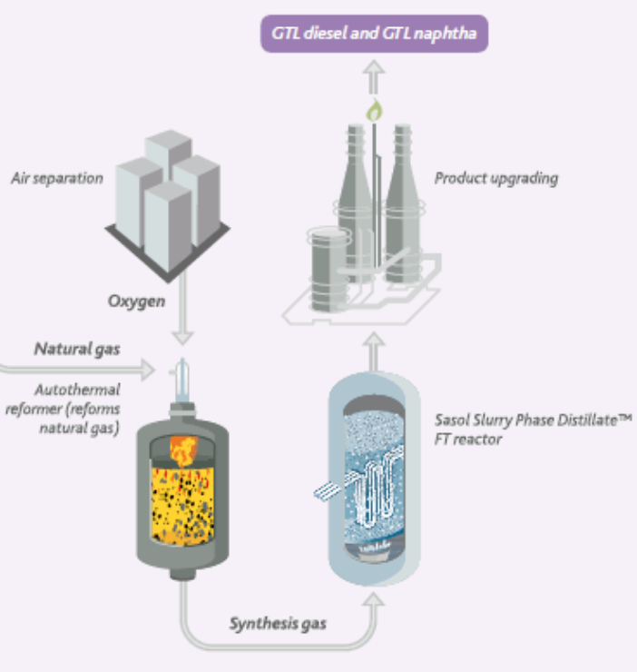
GTL PROCESS SPECIFICATION
Growing demand for efficient and sustainable production of energy and consumer goods makes it possible to monetize methane-rich gas (natural, shale, other) by converting it into premium motor fuels and other chemicals utilizing Fischer-Tropsch process.
The GTL technology is based on the Sasol Slurry Phase Distillate Process™ (SSPD process). It consists of three stages. In the first stage, natural gas combines with oxygen and forms synthesis gas. The synthesis gas is then subjected to a Fischer-Tropsch conversion to form a paraffinic synthetic crude oil. Finally, the synthetic crude oil is cracked to produce the final product - diesel, jet fuel or naphtha.
The strength of the Sasol SPD™ process is not just the inherent quality of three-component technologies, but how they are combined to improve efficiency and optimize productivity.
This seamless integration is based on Sasol's unrivaled expertise spanning over 60 years of synthetic fuels production. Sasol has pioneered the Fischer-Tpropsch synthesis, started to produce synthetic fuels from gasified coal since 1955. This high temperature process, known as Sasol Advanced Synthesis, uses moving bed iron oxide catalysts. This synthesis is used to isolate gasoline fractions and light olefin fractions. Later company focused on a low temperature process known as the slurry distillation process (SSPD). This process uses partial oxidation of synthesis gas using a suspension of wax in water as a catalyst where the Fischer-Tropsch reaction takes place.
SINTEZPROM CORPORATION

Slide 4
GTL technology products
The main products of the Sasol Slurry Phase Distillate Process™ are diesel, jet fuel and naphtha.
GTL diesel has high performance and low emissions with almost zero sulfur content. GTL diesel can be used on existing diesel motors pure or as a raw material for blending. GTL diesel reduces emissions by up to 70% compared to standard crude oil based diesel. Its cleaner and more complete combustion helps to reduce motor deposits. This reduces motor wear, extends motor life and oil change period. GTL diesel can also be blended with standard diesel which significantly improves fuel quality without need for costly refinery retrofits.
Our planet needs environmentally friendly air travel. GTL jet fuel allows airline operators a safe and cost-effective way to reduce emissions. Synthetic fuels are a hallmark of aviation, but GTL jet fuel has the potential to surpass anything previously achieved in terms of performance and emissions. Thus, aviation is one of the most valuable and sustainable global markets for realizing the potential of GTL products.
GTL naphtha being a highly paraffinic product, contains practically no aromatic hydrocarbons or sulfur. At the same time contains a small amount of metal impurities. Light paraffinic naphtha is the most efficient ethylene cracking feedstock. Ethylene is one of the main structural elements of the petrochemical industry. It is a feedstock for the production of various types of plastics, such as polyethylene, polystyrene, etc.
SINTEZPROM CORPORATION

Slide 5
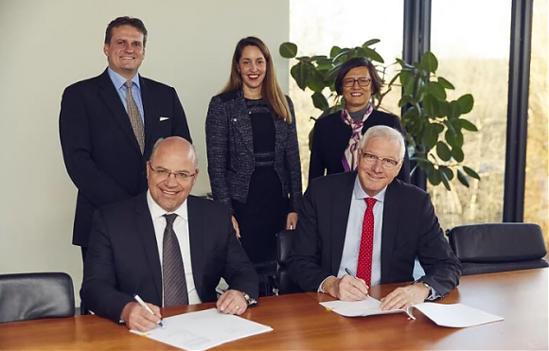
World technology leaders
Sasol Ltd (South Africa) and Haldor Topsoe (Denmark) are two world leaders in gas-liquid conversion (GLC) technology. They entered into a cooperation agreement to jointly license GTL technologies for the production of diesel, jet fuel and naphtha from natural gas in December, 2019.
Previously the companies have worked together on numerous GLC projects and technologies. Topsoe SynCOR™ and Sasol's Fischer-Tropsch technologies have been licensed at several plants. Therefore, the parties decided to continue their cooperation.
As part of the cooperation agreement the companies will continue to offer GLC technologies as well as Topsoe solutions of hydroprocessing, hydrogen production, basic engineering, catalysts and licensed equipment. This open access to a license that covers the entire production chain from gas to liquid fuels.
Unique package offer from Sasol and Topsoe:
Commercially proven and profitable technology;
Single license covering all major technologies for the entire production chain;
Basic engineering, catalysts and equipment;
Experience and knowledge of many operating plants;
Gas warranty at product inlet / outlet.
Sasol Limited is a South African mining, energy, chemical and synthetic fuel company. Company
owns technologies for the production of diesel and liquefied gas based on the Fischer-Tropsch process.
Haldor Topsoe is one of the world's leading companies specializing in the production of catalysts, provision of licensed technologies and engineering in refining, petrochemicals and gas chemistry. The company has R&D offices, manufacturing facilities, sales and service divisions around the world.
SINTEZPROM CORPORATION

Slide 6
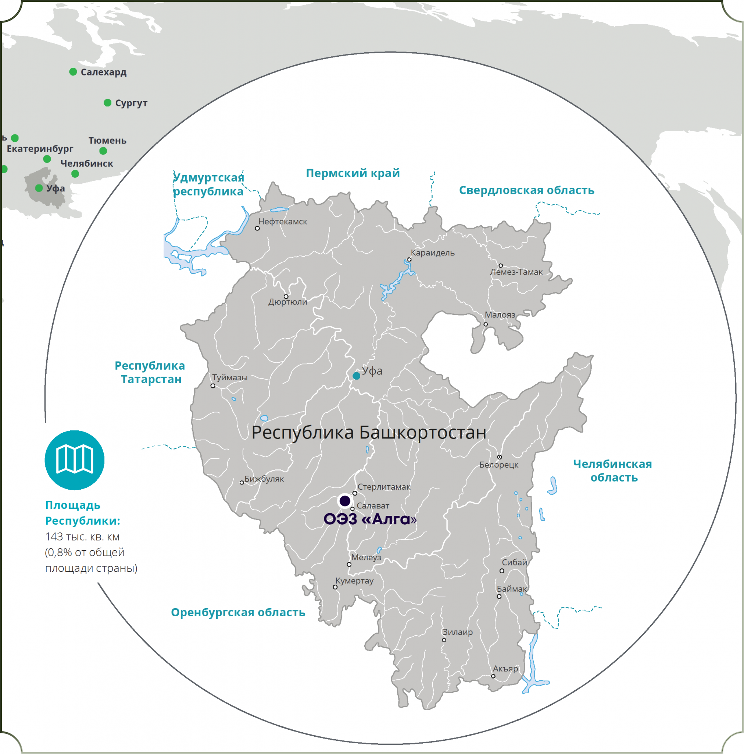
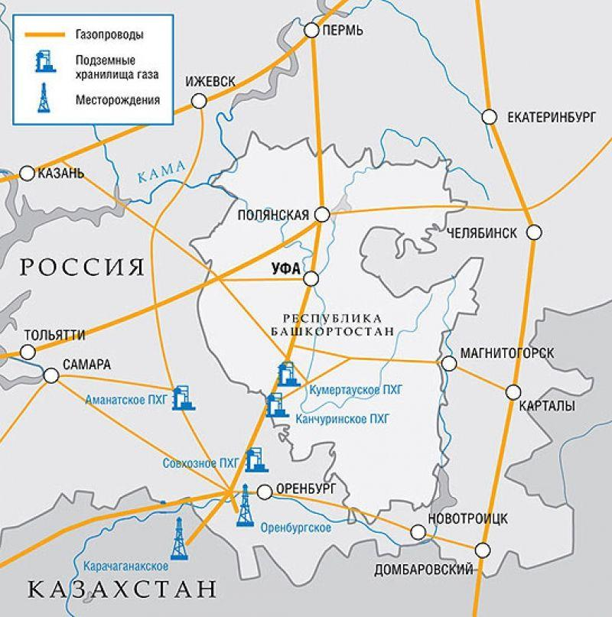
Project information
The purposes of the investment project GTL technology synthetic motor fuel production are the construction and launch of a modern high-tech industrial enterprise - a gas chemical complex (MCC) for processing natural gas into synthetic liquid fuel (diesel) and chemical products.
The project involves creation of a full-cycle production plant from receiving raw materials to the sales of products - synthetic diesel motor fuel.
The capacity of the MCC is 1.5 million bone-dry metric tons, incl. 70% of diesel production and processing 3.6-3.9 billion cubic meters of natural gas per year.
Considering:
favorable location of Bashkortostan at the intersection of the most important pipelines connecting the European part of the country with the Urals, Siberia and the countries of Central Asia;
availability of the material and technical infrastructure;
developed petrochemical industry in the region;
available human resources - production and engineering personnel.
It is planned to locate production in Bashkortostan in close proximity to existing production plants such as Gazprom Neftekhim Salavat, the largest petrochemical complex which include oil refineries and gas chemical plants.
The company will be registered as a resident of the Special economic zone "Alga". The Special economic zone is created on the area of Ishimbay and Sterlitimak regions of the Republic of Bashkortostan in accordance with the Decree of the Government of the Russian Federation of May 27, 2020 No. 764. As a measure of support, residents are provided the possibility of using accelerated depreciation and a reduction factor for the lease of lands. The special status of the zone provides all residents tax benefits and customs preferences which are guaranteed at the state level.
SINTEZPROM CORPORATION

Slide 7
Company
The project assumes creation of a new special purpose company (SPC) in the form of a joint stock company (JSC). The capital will be divided into certain number of shares between the company's members. SPC allows you to effectively manage business processes and financial flows. A SPC is established by the beneficiaries of the project and is created to carry out the transaction, and also acquires ownership rights and related obligations.
A project means the creation and operation of one or more industrial complexes.
It is proposed to distribute shares between the participants of the newly-created company SINTEZPROM JSC as follows: group of russian beneficiaries - 77%, Investment fund - 33%.
When determining the shares in the Company, the rich and diverse experience of the founders, top management, engineering, technical and administrative personnel of both companies, both business and production areas, as well as the following investments are taken into account:
• From the Investment Fund side - investing funds in the Project.
• From Russian Federation side - project and operational management taking into account experience in the fuel, energy and petrochemical business, human resources and management potential.
As part of determining the conditions of the Project, it is proposed to sign an investment agreement. It will contain agreements of the parties, including details of the financing process, the rights and obligations of each of the Project participants, the features of the management structure and options for resolving emerging issues.
At the same time, the investment process must be accompanied by an additional package of documents, including the constituent documents of the joint-stock company, the project financing scheme and dividends policy.
SINTEZPROM CORPORATION

Slide 8
ROAD MAP
The project "GTL technology synthetic motor fuel production" includes the following stages:
Stage 1 - Investment
4 years from the signing the agreement with the Investor. Necessary for the preparation of the project, construction, installation and commissioning works
Stage 2 - Commissioning
1 year from the date of production launch. The stage provides commissioning of production and reaching the goals of capacity
Stage 3 - Operational
Assumes the achievement of targets for the production and sales
SINTEZPROM CORPORATION

Slide 9
Operational sctructure
1F CORPORATION
ENGINEERING & CONSTRUCTION STAGE
1F ENGINEERING
100% subsidiary
1F CONSTRUCTION
100% subsidiary
Researchers
Consultants
Experts
Designers
Contractors
Service companies
Experts
Consultants
Suppliers
80% group of russian beneficiaries
20% Investors
BIM operators
SINTEZPROM CORPORATION
77% group of russian beneficiaries
Strategic management
Business Development
Industrial Site
33% Investor
Partner development
Industrial site Development
Operational control
Owner control
Technology Development
SINTEZPROM URAL
Investors relations
Product development
Government relation
SINTEZPROM NORTH
SINTEZPROM WEST
SINTEZPROM EAST
Financial management
HR management & development
other consortium
New experience and competencies gained during the construction stage of the project are valuable assets that can be monetized. For this reason, an engineering and construction corporation is being created to implement the project. External orders from the energy, oil and gas sectors of the economy are also expected.
SINTEZPROM CORPORATION

Slide 10
Project roadmap
Review of the financial model and preliminary approval.
Issue a memorandum of intent, indicating the share in the SPC, the cost of the loan and its term.
Acquisition of technical specifications from the PJSC GAZPROM by the initiator of the SPC project.
Loan agreement and a share purchase agreement in SPC are signed simultaneously.
The investor appoints its representative to the SPC board of directors to maintain a transparency treatment of project costs.
The purchase price of shares is 150 million roubles (approximately $1,918 million). Payment is made to PGS365 LLC.
6.1. Funds almost in full will be donated to the SPC company to start the operations. This amount is 125 million roubles. (approximately $ 1,599 million);
6.2. 6% tax (Simplified tax system mode) = 9 million roubles (approximately $0.115 million) will be transferred to the government;
6.3. 16 million roubles (approximately $0.205 million) PGS365 LLC will spend on its side for the benefit of the project without report or with partial report.
The investor is obliged to start fulfilling obligations under the loan agreement after purchasing shares in SPC.
The side of the project initiator forms the project team, performs other organizational tasks to ensure functioning of the SPC company.
Parties begin implementation after project plan is formed.
SINTEZPROM CORPORATION

Slide 11
conditions
The implementation of the project is carried out only on the basis of the completion of the construction stage by the newly established EPC contractor.
The project initiators will staff the contractor's EPC teams with top managers and engineering personnel.
All required permissions for design and construction are registered for this corporation.
Loan agreement, agreement for the purchase of shares in SPC and shares in an EPC contractor are signed simultaneously.
The investor appoints its representative to the EPC contractor board of directors to maintain a transparency treatment of project costs.
The purchase price of shares is 80 million roubles (approximately $1,000 million). Payment is made to PGS365 LLC.
6.1. Funds almost in full will be donated to the SPC company to start the operations. This amount is 60 million roubles. (approximately $0,750 million);
6.2. 6% tax (Simplified tax system mode) = 4,8 million roubles (approximately $0.06 million) will be transferred to the government;
6.3. 15,2 million roubles (approximately $0.190 million) PGS365 LLC will spend on its side for the benefit of the project without report or with partial report.
In addition to design and construction, an experience parameter is formed for the EPC contractor to participate in competitive procedures for similar projects.
The side of the project initiator forms the project team, performs other organizational tasks to ensure functioning of the SPC company.
Parties begin implementation after project plan is formed.
SINTEZPROM CORPORATION

Slide 12
Investments
The required investment amount is 308,361,624,772 roubles as by calculations in the financial and economic model of the Project, including following types of expenses:
Item / Investments | Total, rub.
Project work | 29 600 000 000
Construction | 79 920 000 000
Equipment, Installation & Commissioning | 186 480 000 000
General & Administrative expenses | 7 234 444 800
Business expenses | 570 111 625
Additional expenses | 4 557 068 346
Total | 308 361 624 772
Funding is provided through a loan from the Investment Fund. Assumed terms of financing from the Fund:
Name | Value
Term, years | 30
Financing type | Loan
Loan interest | 0,5 % per year
SINTEZPROM CORPORATION

Slide 13
Investment offer
Project indicators | Total, RUB
Free Cash Flow | 736 528 834 544
Discount rate,% | 6,5%
Net Present Value (NPV) | 334 582 599 556
Internal Rate of Return (IRR) | 7,1%
Pay-back period (PP) | 16
GTL technology synthetic motor fuel production project implementation is a promising area that meets the trends of the Russian Federation fuel market and provides a high profit levels.
Clear competitive advantages give the project opportunity to become a successful in the Russian and Global petrochemical industry.
We offer you take part in the Project, become its business partner and strategic investor.
SINTEZPROM CORPORATION

Slide 14
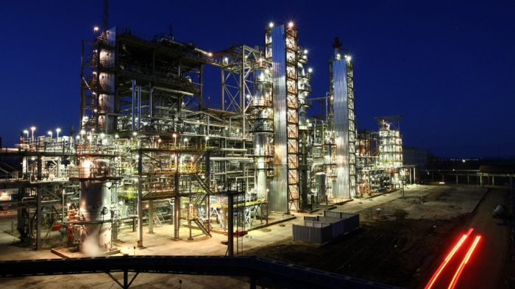
Thank you!
WE WILL BE GLAD TO ANSWER YOUR QUESTIONS
CEO Damir bachtiyarov
+7 9273575755
www.sintezprom.com
E-mail: alexeyshafikov@outlook.com
AdDress: Russia federation, ufa city, zlobina street, 31/6

